Slide 1
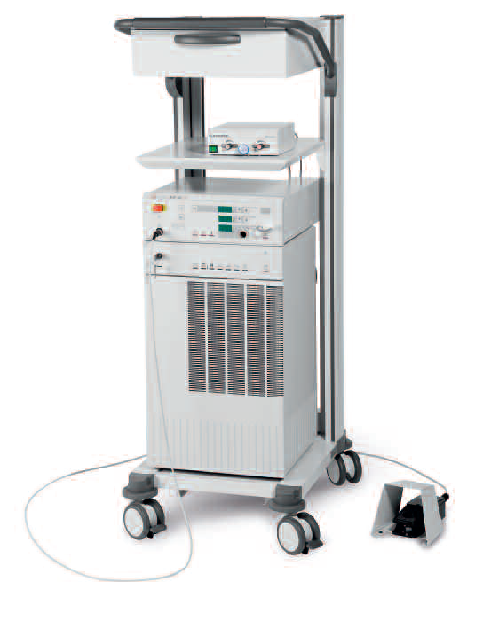
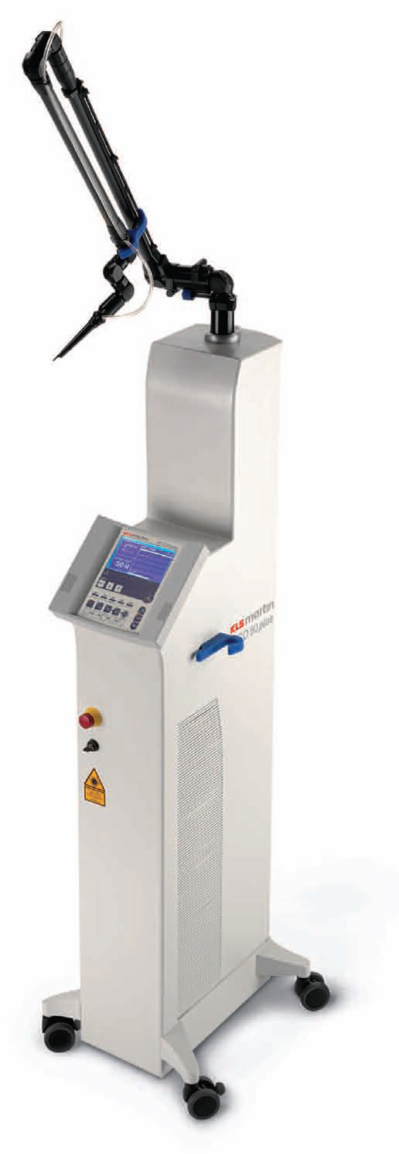
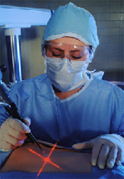
MEDICAL LASER SYSTEMS
Assist Prof. Dr. Lutfi Ghulam Awazli
Institute of laser for postgraduate studies
University of Baghdad

Slide 2

INTRODUCTION

Slide 3
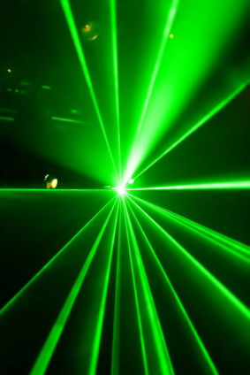
LASER FUNDAMENTALS (PROPERTIES)
What is LASER?
The word LASER is an acronym:
Light
Amplification
by
Stimulated
Emission
Of
Radiation

Slide 4
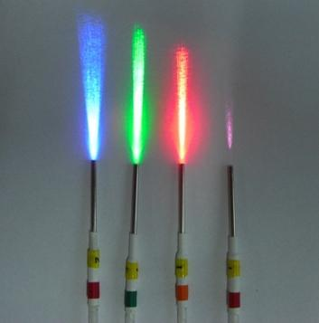

What is LASER ?
LASER is a concentrated narrow beam of coherent, collimated, monochromatic light with a high energy travelling in a particular direction ( unidirectional).
Laser is a light with special properties
These properties include :-
Coherent : all waves are in phase, synchronized
Collimated: parallel, no divergence, very narrow beam
Monochromatic: single color, single wavelength
Unidirectional: one direction
Highly focused: concentrated with pinpoint accuracy
Brightness : extremely high-intensity( high energy)
These unique characteristics make the laser useful for thousands of applications including medical applications.

Slide 5
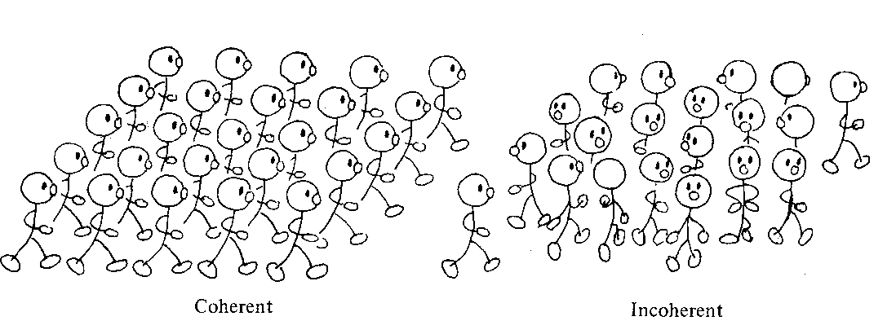

Slide 6
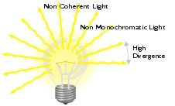
DIFFERENCE
LASER LIGHT
ORDINARY LIGHT
1. Coherent : in phase (in harmony)
2.Collimated: parallel
very narrow beam
no divergence
3.Monochromatic: single wavelength single color
4. Directional: unidirectional
5. Brightness : extremely very high
power density
Incoherent : random phase
2. Not collimated: unparallel
very wide beam
high divergence
3. Many wavelength Many color
4. Multi directional
5. Brightness : very low power density

Slide 7
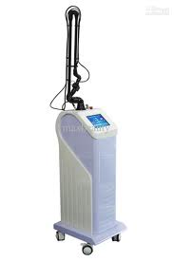
Laser system is a device that emits intense concentrated narrow beam of light which is Coherent , Collimated , and Monochromatic through a process of optical amplification based on the stimulated emission of electromagnetic radiation , and operates in the infrared, visible, or ultraviolet region of electromagnetic spectrum.

Slide 8
400
475
620
700
400 700
Visible light has a wavelength range of 400 – 700 nm and can be seen by the eye.

Slide 9
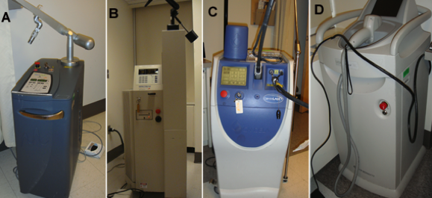
Different kinds of lasers that have been used for medical treatments.
Figure. Clinical lasers.
(A) Q-switched ruby 694 nm made by Spectrum used for tattoo and pigmented lesion removal;
(B) Long-pulse alexandrite 755 nm Candela Gentlelase used for removal of hair and vascular lesions;
(C) Diode laser at 800 nm Luminis LightSheer, used for hair removal and leg vein treatment;
(D) Q-switched Nd:YAG at 1064 nm ConBio Medlite used for removal of black & blue tattoos and pigmented lesions.

Slide 10
SURGICAL LASER SYSTEM :
Common lasers used in surgery include :
- CO2 laser : 10600 nm General surgery, Gynecology , ……
- Nd:YAG lasers : 1064 nm General surgery, …….
- Ho:YAG lasers : 2100 nm Urosurgery, Orthopedics,…..
- Diode lasers : 810 nm Vascular surgery, ENT surgery,…
- Dye laser : 570 nm Vascular surgery
- Excimer laser : 193 nm Ophthalmology

Slide 11
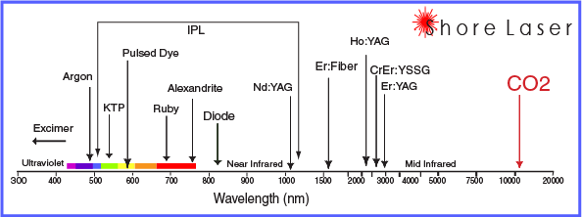
2100
10600
1064

Slide 12
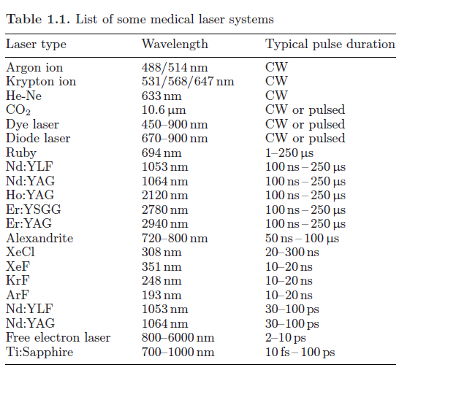

Slide 13
MEDICAL APPLICATIONS OF LASER
Diabetic retinopathy, Retinal detachment, Correction of vision (LASIK) Glaucoma, ……… | Ophthalmology
Portwine stains of the face, haemangiomas, telangectasias, Papillomas Tattoos, Keloid, Skin resurfacing, Viral warts, Multiple melanoma, ….. | Dermatology
Ca larynx, Polyp, Papilloma, Vocal cord nodule, Leukoplakia, Tonsillectomy,Tympanoplasty, Myringotomy, Laryngeal stenosis | E.N.T
Carcinoma in situ of the cervix,Endometriosis, Fallopian tube surgery Myomectomy, Cystectomy, Vaginal and Vulval lesions, …….. | Gynecology
(GIT surgery, Biliary tract surgery, Anal surgery),Breast surgery,Wound debridement and ulcer excision, Endoscopic and Laparoscopic surgery | General surgery
Laser lithotripsy, Prostatectomy, Superficial bladder carcinomas urothelial tumors, Urethral and ureteral strictures, Bladder neck incision | Urosurgery
Laser Angioplasty, Laser endarterectomy, Laser ablation of lower limb, Recanalization of atherosclerotic vessels. Microvascular welding | Vascular surgery
Cerebral glioma, Acoustic neuroma, Intracranial meningiomas, ………. | Neurosurgery
Dental hard tissue treatment Dental soft tissue treatment, | Dentistry
Control bleeding, Palliative treatment of inoperable bronchial carcinoma Photodynamic diagnosis of bronchial carcinoma,…… | Thoracic surgery
Sinovectomy, Percutaneous laminectomy,Meniscectomy, Bone ablation | Orthopedic surgery

Slide 14
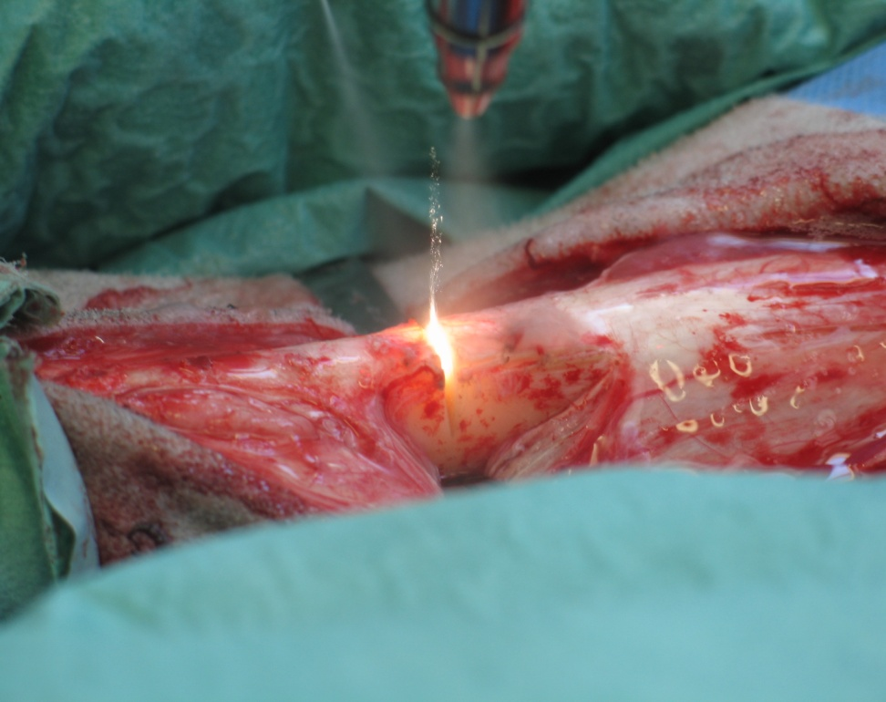
LASER SURGERY is a type of surgery that uses LASER instead of standards tools or instruments such as ( a conventional scalpels, electrocautery units, cryosurgery probes, for surgical procedures like mastectomy, cholecystectomy, stones fragmentations and so on…
Lasers in surgery are used to :
cut
coagulate
vaporize or
ablate the tissues with little or no damage to surrounding areas.

Slide 15
Laser surgery as effective and safe procedure is well established in 1981 due to:-
1- The development of new laser technology and technique.
2- Finding of new and cheaper fiber optics which is used in endoscopy.
3- Understanding the concept of laser tissue interaction .
4- Availability of new high-power surgical applications technique including . laser interstitial thermal therapy ( LITT ).
5- Safety precautions.
So Within the last 30 years, laser surgery has become a widely performed procedures.
If properly used effective and safe
If improperly used not effective and unsafe dangerous
For this reason, a basic knowledge of lasers and their applications is essential to every surgeon.

Slide 16
Potential advantages of laser
Why we use laser in surgery ?
Laser Surgery may have certain advantages as compared with other surgical instruments. These include:
1. provides a clear, dry surgical field (bloodless field), thus aided to the surgeon visibility and precision during the surgery i.e.: cuts and coagulates at the same time.
2. Reduce Bleeding: ( in very vascular lesions there is minimal bleeding ),
laser energy cauterizes and seals small blood vessels, so achieves homeostasis.
3. Reduce Swelling and edema : laser energy seals lymphatic vessels, and reduces tissue trauma, so minimizes inflammatory responses, reducing swelling.
4. Reduce Infection: The laser energy acts as an antimicrobial/antibacterial agent by producing high temperatures, which effectively eliminating microorganisms.
5. Reduce risk of transmitted infection because no physical contact with the patient ("no touch" technique).
6. Reduce local tumor recurrence Reduction in the spread of metastasis by killing of malignant cells by (direct anticancer effect) and sealing of lymphatic vessel.
7 Reduce Pain: The laser beam seals nerve endings as it incises through tissue.
8. Reduce the need for G.A: Commonly under local or no anesthesia
9. Reduce recovery time: so the patient return rapidly to normal daily activities
10. Reduce of operative time.

Slide 17
11. Precision, highly precise incision, not affect the surrounding tissues. i.e. - This advantage is very helpful when a doctor must operate in a tiny area that is surrounded by important structure or organs. (Microsurgery).
A focused laser can make incisions half a micron wide, compared to about 80 microns for the diameter of a human hair.
12. Less scarring and better cosmetic effect
13. Fewer instruments in the field.
14. Finally: Laser surgery is much safer than conventional surgery because:
- reducing the need for general anesthesia
- reducing the need for blood transfusions
- reducing the risk of infection
- shorter hospital stay
NOTE:-
Although laser surgery provide many advantages, it is unlikely that they will completely replace scalpels and other “standard” instruments.

Slide 18
Disadvantages of laser :-
Laser surgery is far more expensive than the conventional surgery (i.e. cost effectiveness is poor).
Laser surgery requires training in laser basic and surgical techniques.
Need safety precautions so that the patients, the staff, and the surgeons are protected from laser hazard especially the eyes, so protective glasses are required during its use.
Loss of tactile sensation in using laser (commonly non touch technique).

Slide 19
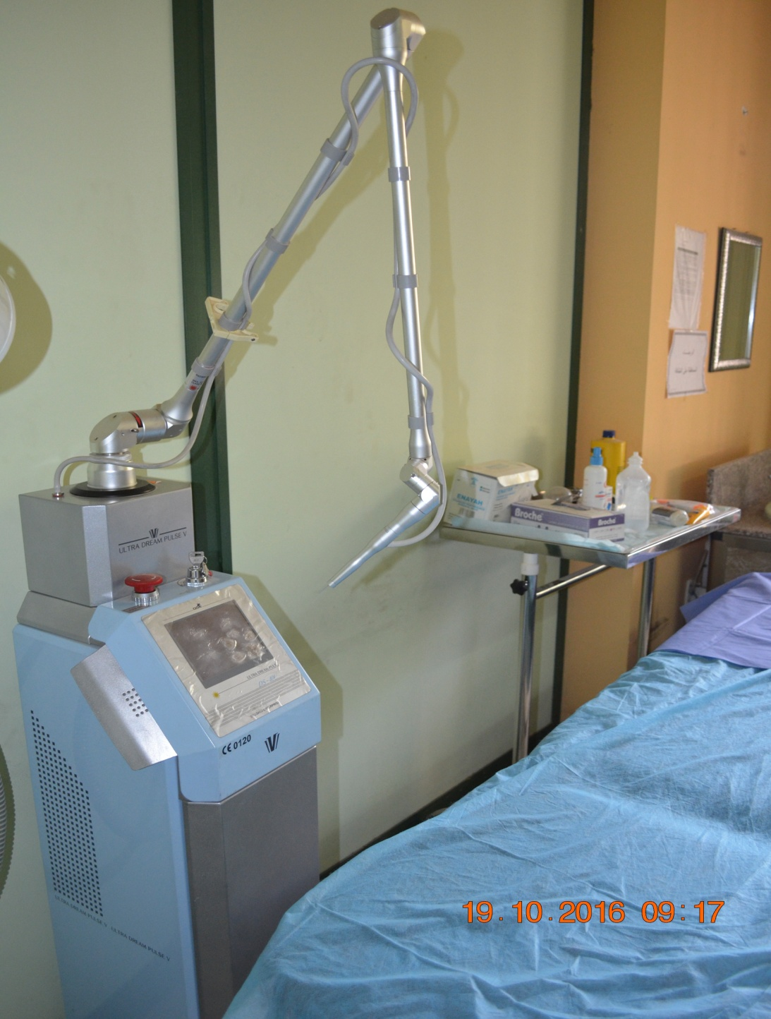
CO2 laser 10600 nm

Slide 20
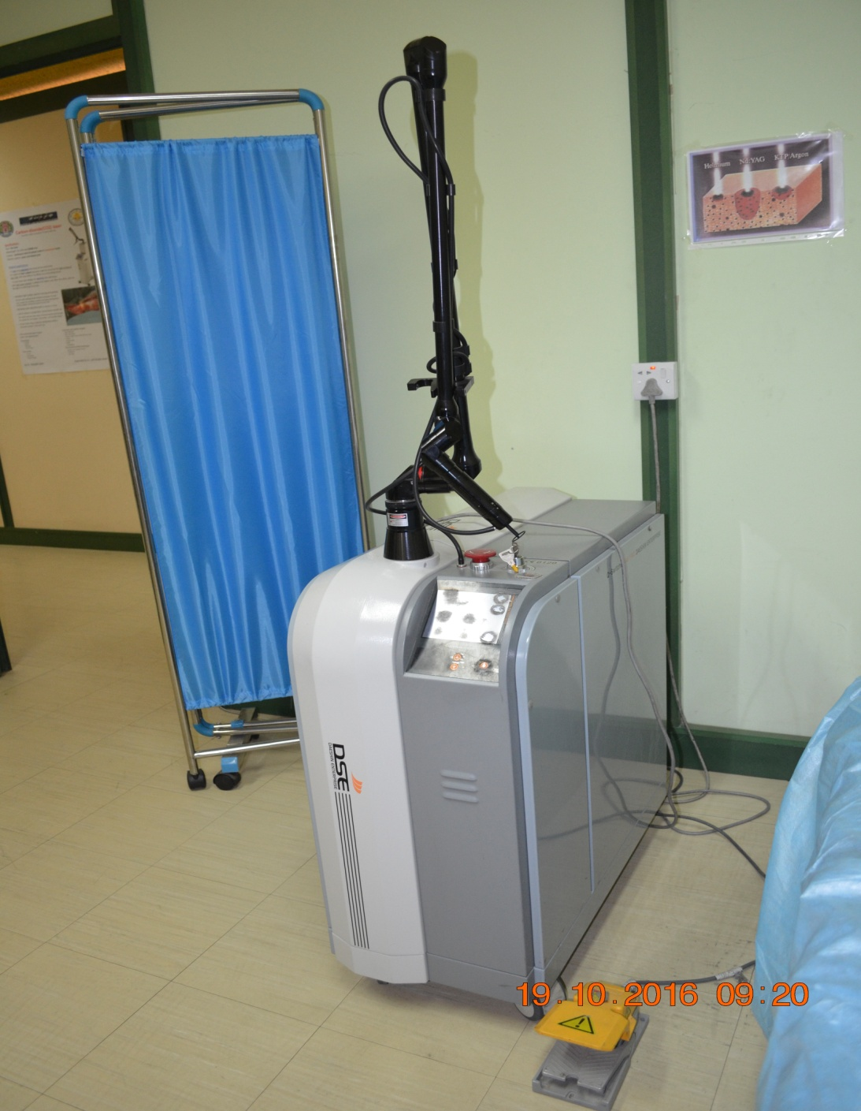
Q-Switch Nd:YAG laser
1064 nm , 532 nm

Slide 21
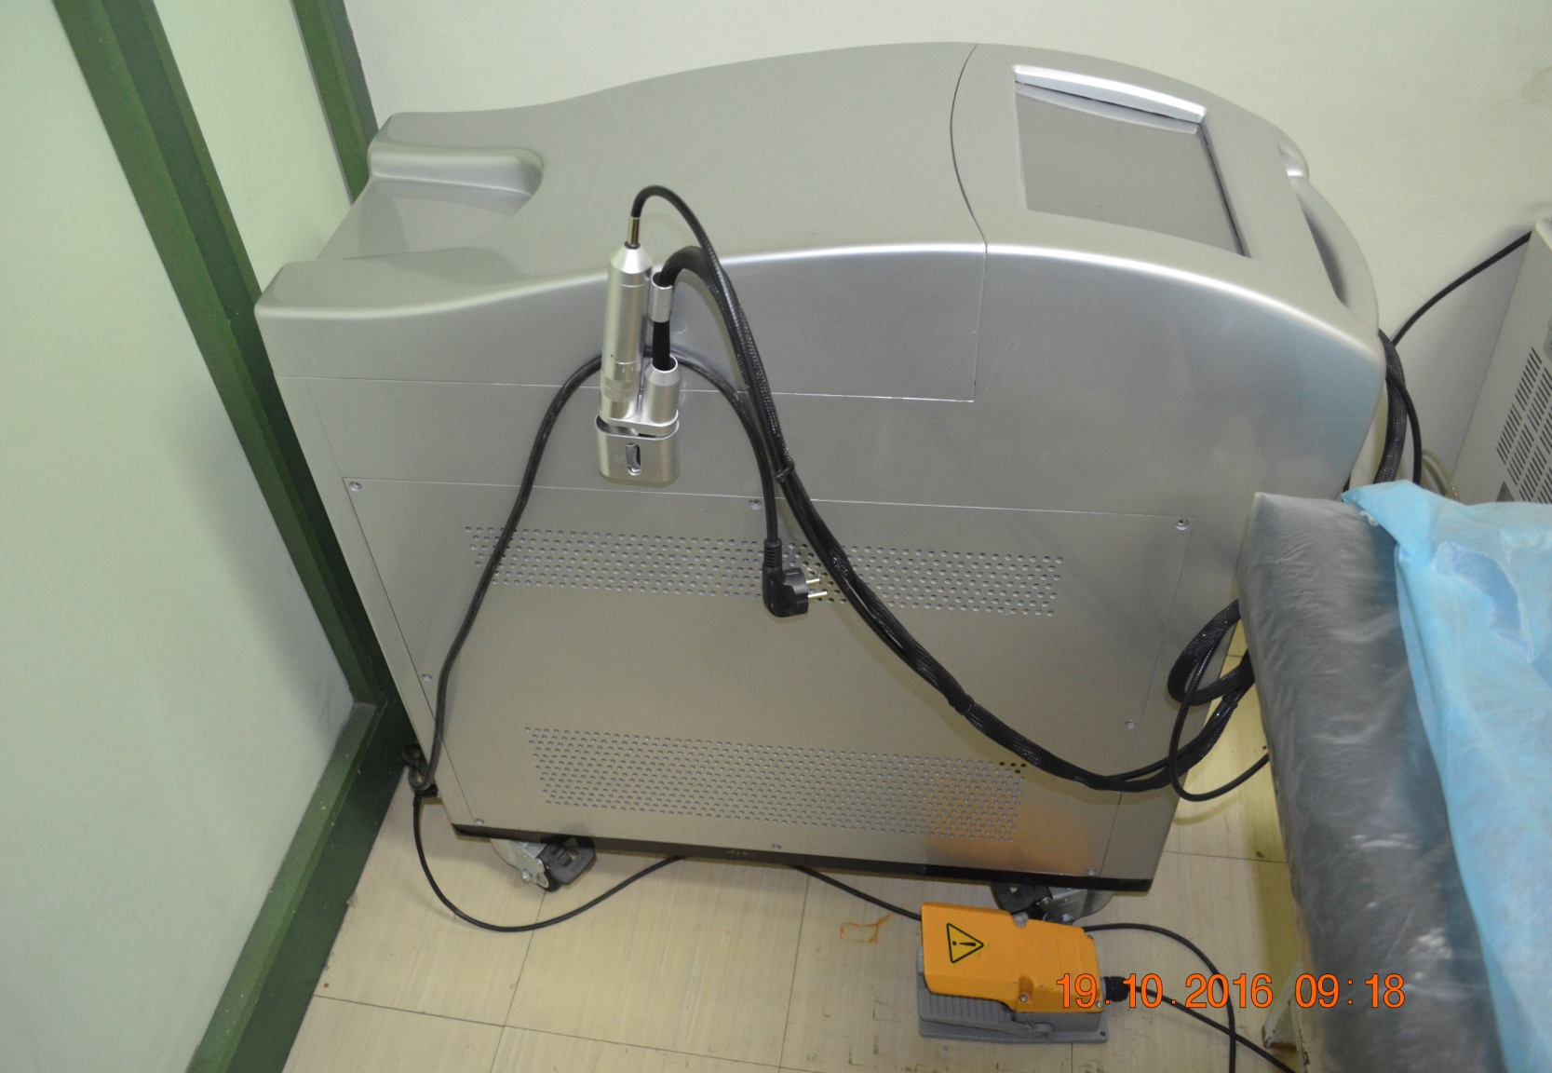
Long pulse Nd:YAG laser 1064 nm

Slide 22
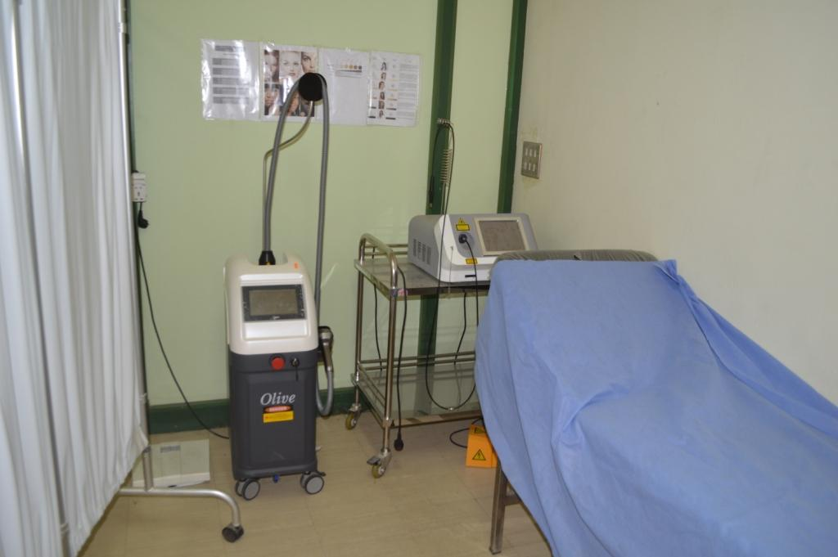
Diodes 980 nm, 810 nm

Slide 23
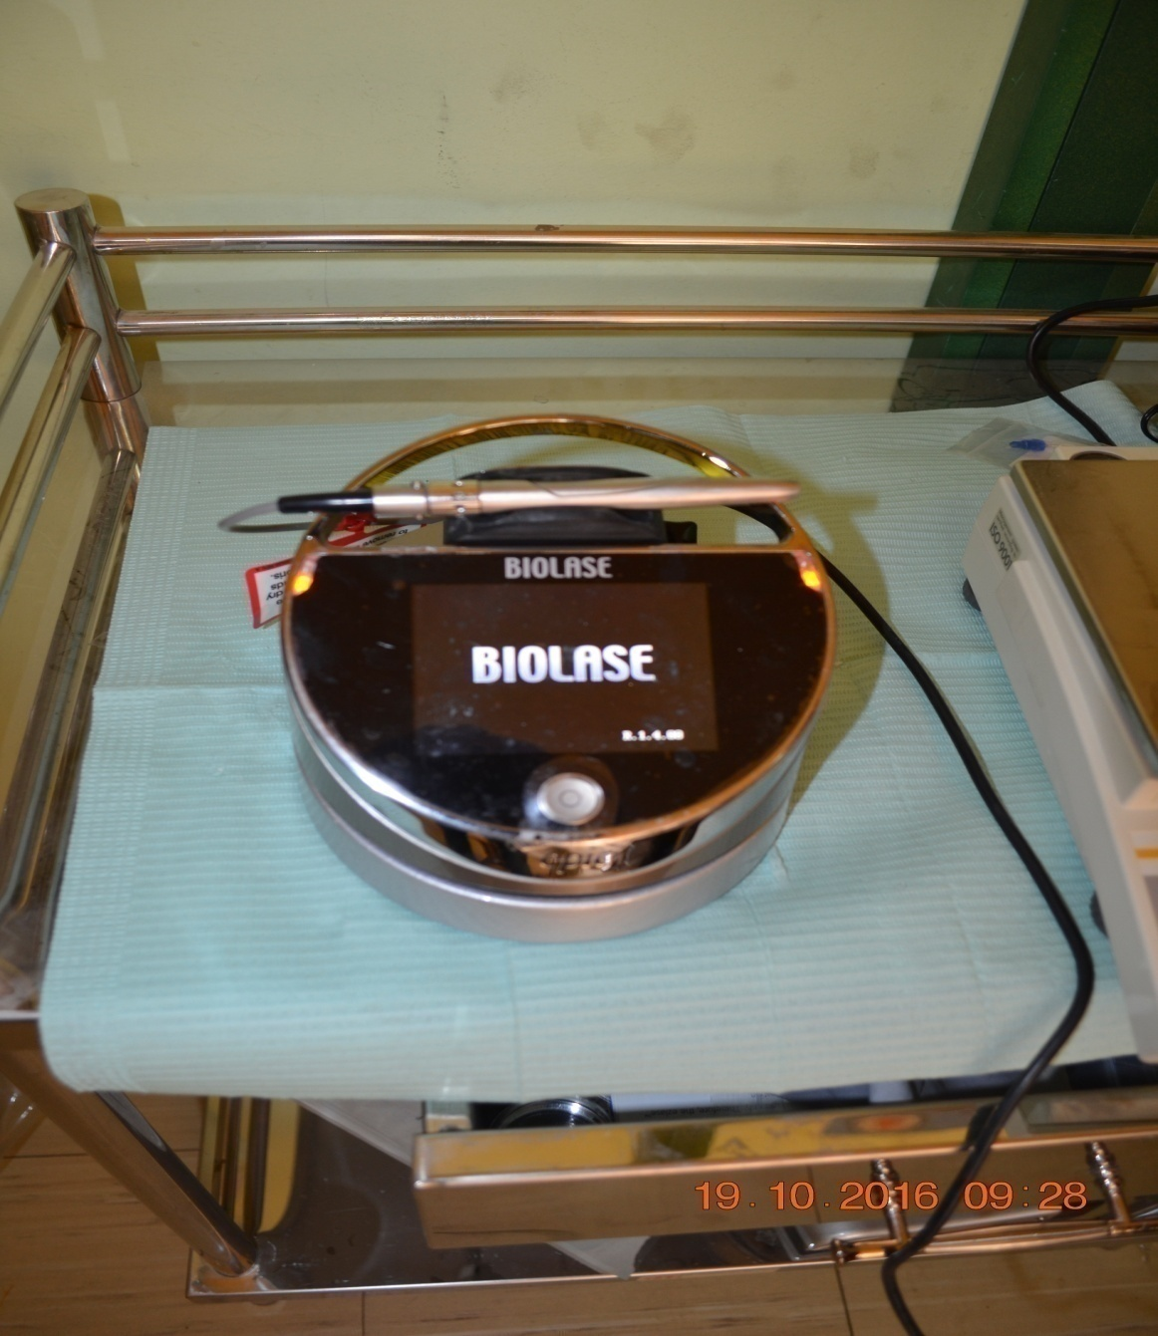
Diode laser 940 nm

Slide 24
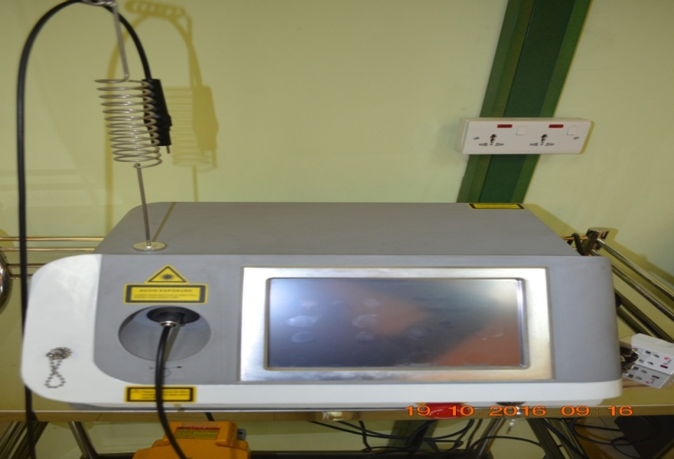
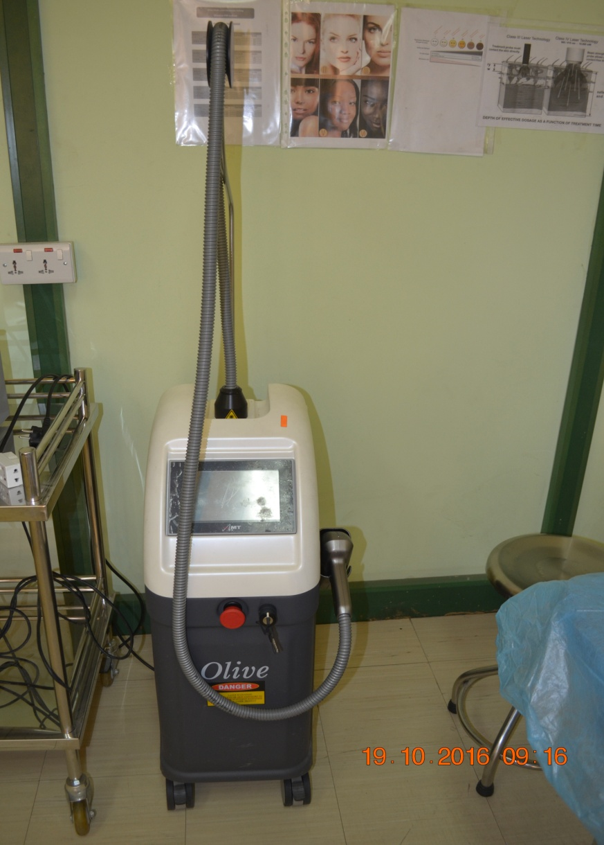

Diode laser 980 nm
Diode laser 810 nm
Diode laser 940 nm

Slide 25
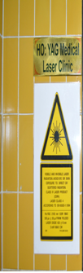
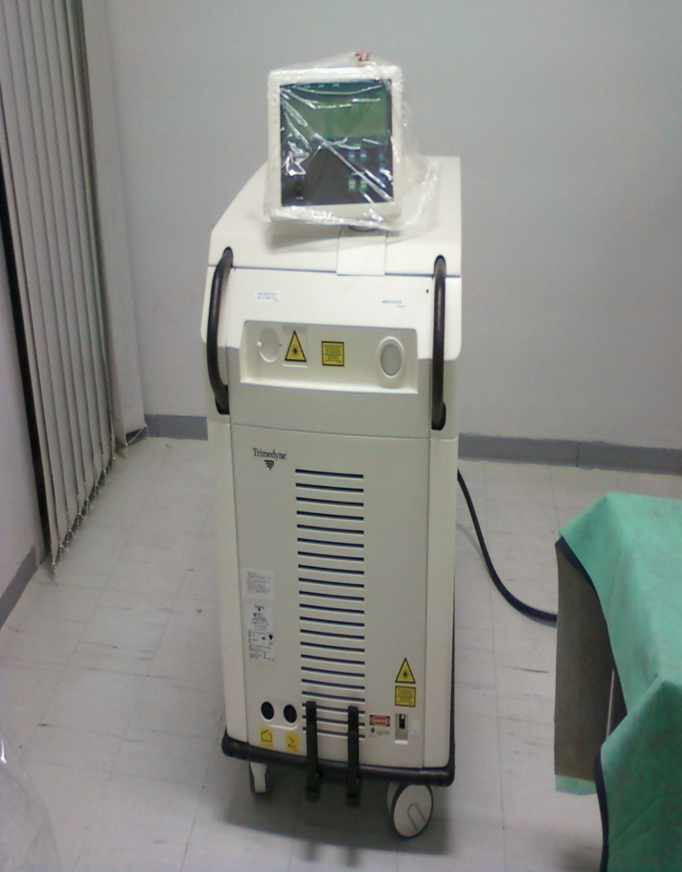
Ho:YAG laser 2100 nm

